Slide 1

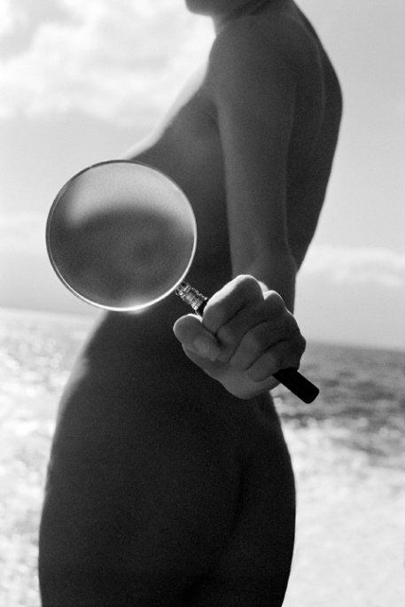
Who Cheats and
Why?
Leanna Wolfe and Ava Cadell
Society for the Scientific Study of Sexuality
April 10, 2010 - Palm Springs, CA
Notes:
Welcome everybody, we’re really excited about sharing our Cheating survey and report with you.

Slide 2
Internet Survey
May 2008 – April 2009 (11 months)
12 Questions
1055 completed surveys (98% completion)
Voluntary
(No financial compensation provided)
Insight into why people seek extra-relationship sex
Responses revealed differences in age and gender
Notes:
Leanna - designed a survey with 12 easy question and we received a high response of 98% completion rate in this voluntary survey which gave us insight in to why people seek extra relationship sex. We found differences in age and gender. There is no Cheating community unlike the Polyamory community, who love to network with each other. This took us nearly a year to get over 1000 responses.

Slide 3
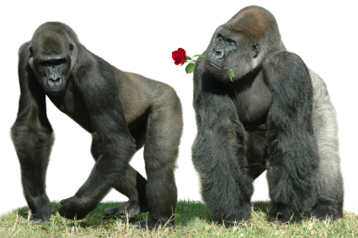
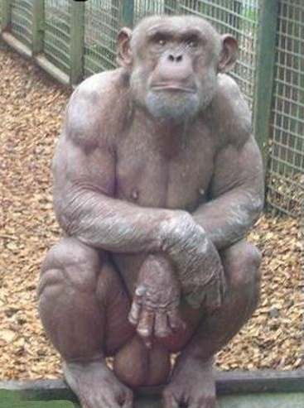
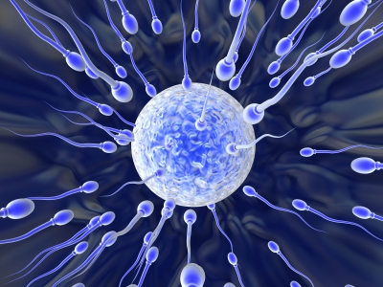
Evidence of Non-MonogAmy
1. Sexual Dimorphism
2. Testicle Size
3. Sperm Competition
Notes:
Leanna -The first indicator of non-monogamy is Sexual Dimorphism, briefly what that means is differences in size and shape between the male and the female. An example here the gorilla where the male is twice the size of the female. Our males are not twice the size of females, but on average they are larger. The next indicator of non-monogamy is testicle size. Now here’s a handsome chimp with pretty excessive balls. The reason a chimp has such large testicles is so that he can engage in sperm competition. Human males have relatively large testicles, not as large as the chimp, but large enough to engage in sperm competition. Sperm competition is where there’s sperm from the ejaculates of multiple males who are competiting to fertilize an egg. In fact the ejaculate of any male contains 3 different kinds of sperm; blockers, egg penetrators and fighters. Humans and many mammals engage in sperm competition so this is another indicator of non-mongamous species.

Slide 4
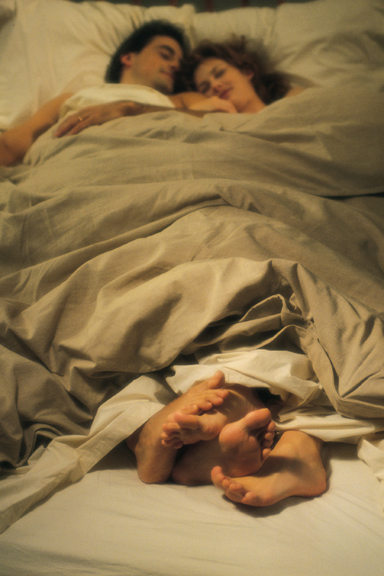
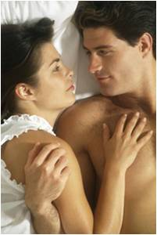
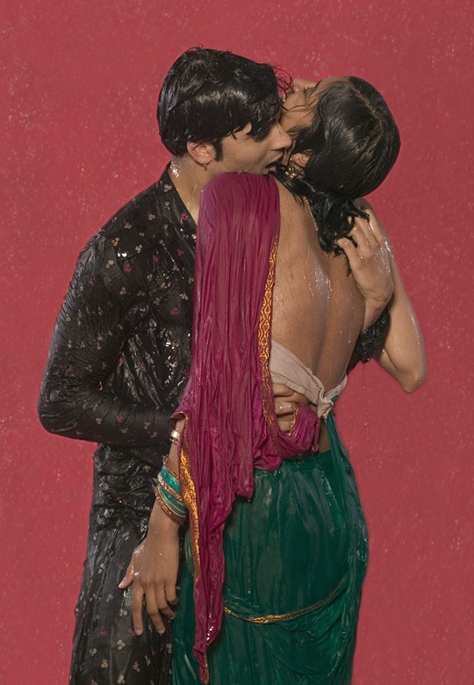
brain Chemistry of romantic love
Attraction phase
Attachment phase
Lust
Notes:
Leanna – Another area that is important in understanding cheating, is understanding the chemistry of Romantic Love. There are 3 phases of Love beginning with Lust, which is largely driven by Testosterone, the sexual hormone. The next phase is the Attraction phase where we experience high levels of dopamine, norepinephrine and intense focus on each other. This is also known as the “Love Sick” phase. The final phase of Romantic Love is the Attachment phase and as you can see in this picture, they get cuddly as they experience high levels of serotonin and oxytocin, so they feel safe in their commitment and to each other. In this phase, they may be vulnerable to engage in cheating to kick up the feelings of lust that have dissipated, or kick up dopamine love-sick phase again because their brains maybe hungry for these powerful feelings that are no longer there.

Slide 5
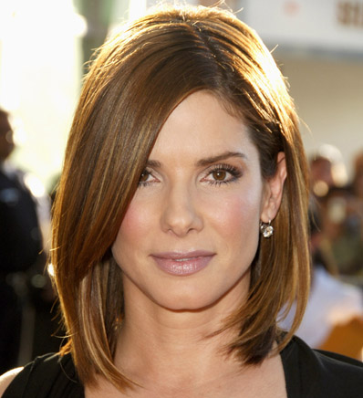
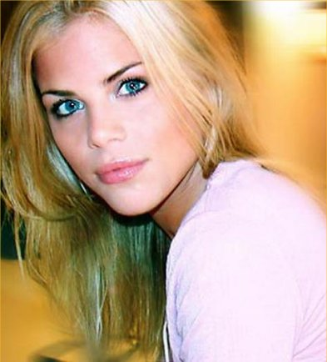
Pop Culture’s Impact on Cheating
Exploitation of celebrity relationships
Cheating patterns exposed
“If Sandra Bullock can’t
keep her man faithful, how
can I?”
“How could Tiger screw around
when he has such a beautiful,
young sexy wife?”
Notes:
Ava – The exploitation of celebrities cheating in the media has captured the publics imagination. And what we find is a cheating pattern that correlates to the 3 phases of Love so that cheaters like Tiger Woods and Jesse James who were both in the Attractive phase of their marriages, were easily tempted to cheat by numerous women. The impact on the general public leads to a lot of confusion about why people cheat, most don’t understand the theory that we are not monogamous by nature or that we are flooded by hormones that make us vulnerable to cheating. So they are quick to judge celebrities and make themselves feel inadequate by saying things like: If Sandra Bullock can’t keep her man faithful, how can I? or How could Tiger screw around when he has such a beautiful young sexy wife. We know that it has nothing to do with how good we look, how famous or successful we are, but how we much we need to have our basic sexual and emotional needs met.

Slide 6
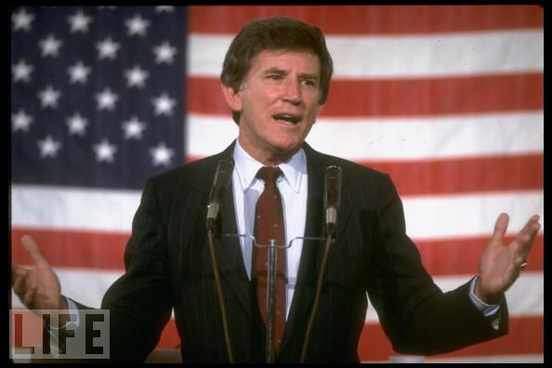
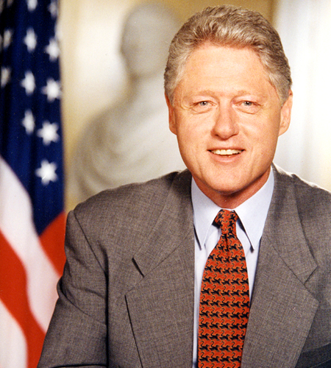
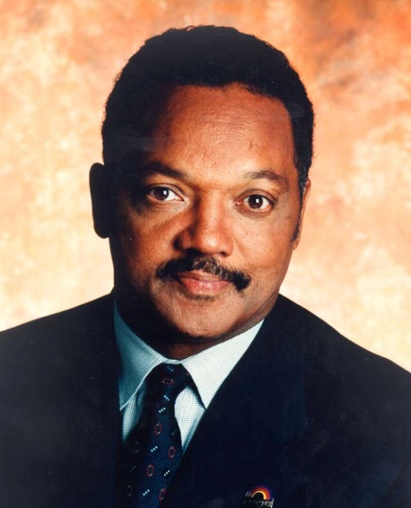
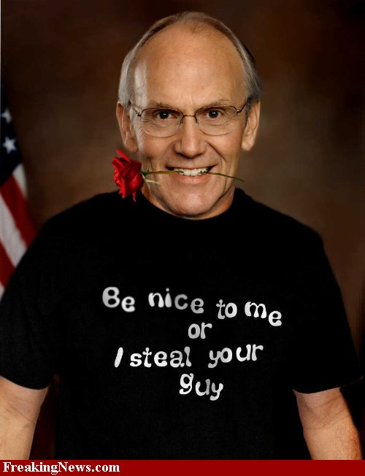
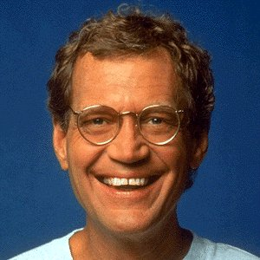
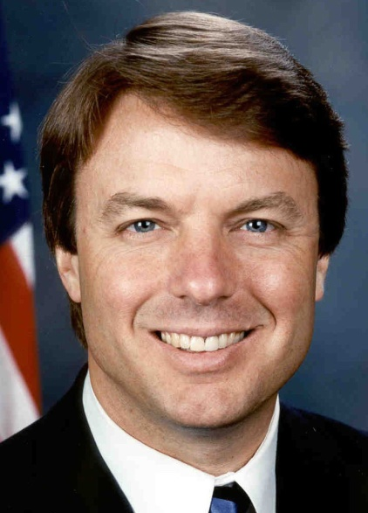
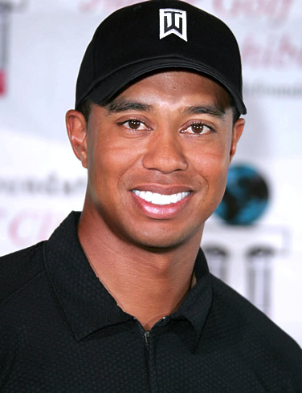
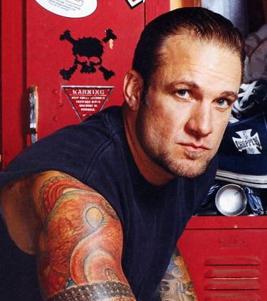
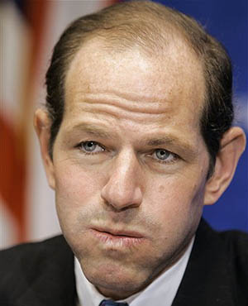
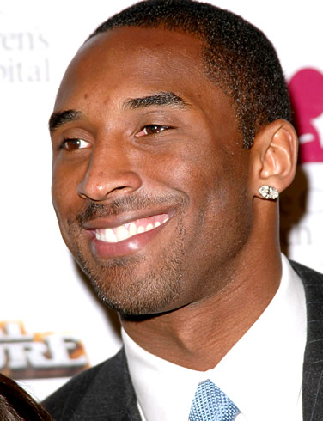
The Media’s courtship with cheaters
Notes:
Leanna – One of the first major cheaters to get caught by the media was Gary Hart back in 1988 when he was running for President, he taunted the media about following him with his then girlfriend Donna Rice and they did. The next big expose was Bill Clinton, which started way before he and Monica Lewinsky were discovered in the White House. He became very repentant and claimed that he would bring Reverend Jesse Jackson to help him, but interestingly at that time, Jesse Jackson was fathering an out of wedlock child, but he never pulled the same attention as a cheater that Bill Clinton did because Jesse Jackson always owned up to the child, paid child support, his wife knew about his lover, so he diffused a lot of the publicity himself. Now there have been a lot of other men who have been accused of cheating in the media including, Senator Larry Craig who is gay cheater, David Letterman who was blackmailed for cheating, but ultimately announced that he cheated with his staff live on his show, Jesse James married to Sandra Bullock who is in the process of divorcing him for cheating, Elliot Spitzer former Governor of New York who stepped down for cheating, Kobe Bryant cheated and continued to play basketball better than ever. Now the last 2 cheaters have gained the most media attention, first John Edwards denied cheating, then he denied fathering a child, then Tiger Woods also tried to deny his cheating so the media had a heyday uncovering all of his mistresses.

Slide 7
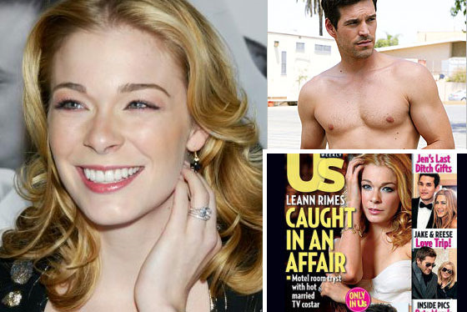

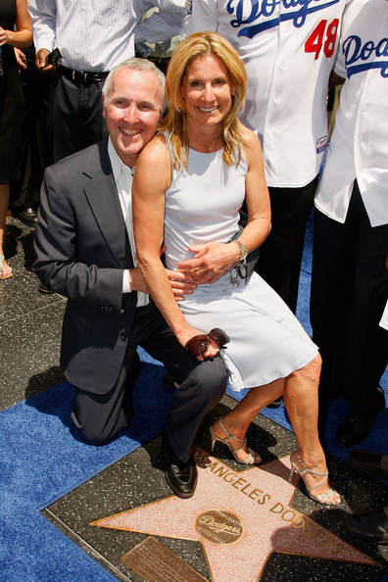
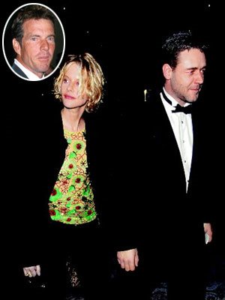
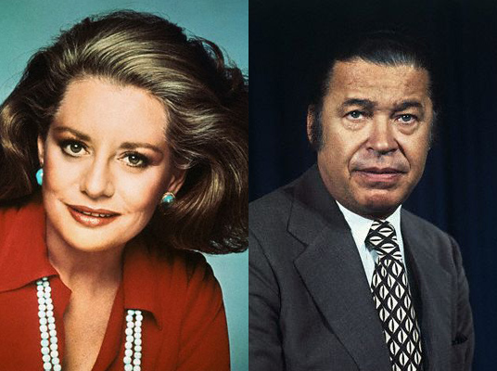
The Media’s courtship with cheaters
Meg Ryan while married to actor Dennis Quaid, cheated with actor Russell Crowe
Barbara Walters cheated with
married Senator Edward Brooke
Leann Rhymes, while married, cheated with married actor Eddie Cibrian
Jamie and Frank Mccourt cheated on each other with their employees
Notes:
Ava - Cheating has no gender barriers and women are cheating more than ever perhaps because they are becoming more economically independent and taking responsibility for their own pleasure. So who are some of the most famous women cheaters? Barbara Walters actually admitted, “I had an affair with a married black Senator” in her recent memoirs three decades after the affair with Senator Edward Brooke. Meg Ryan cheated on her husband actor Dennis Quaid with actor Russell Crowe while filming 2000’s Proof of Life because she caught her husband of 10 years cheating first. The media caught married Singer Leann Rimes and married actor Eddie Cibrian cheating in a restaurant as they were locking lips. And finally, billionaire owners of the Dodgers Frank and Jamie McCourt cheated on each other with their team employees. Now they’re battling it out in the most expensive divorce in California history estimated at 19 million dollars. Many of these women are Combo Cheaters, who have both cheated and been cheated on. We’ll get into more detail on Combo Cheaters later on in our survey.

Slide 8
Cheating Survey Participants
Males 43%
Females 57%
61% have been cheated on
59% have cheated on a partner
57 % have been a secret lover
Notes:
Leanna – Now I’m going to talk to you about our survey participants. As you can see we had more females responding than males. We had a really high percentage of people who participated in the Cheating Triangle. We had 61% who had been cheated on, we had 59% who had cheated on a partner and 57% who had been secret lovers so as you can see, many of our respondents had been part of all three corners of this triangle.

Slide 9
Notes:
Leanna – Let’s look at the differences in the age of our male and female respondents. What we can see is that our females were younger than our males and we have the average age of females coming in at 24 to 35 age range where the average age of males is 46 to 55. We had males up to over 76 who were interested in talking about cheating.

Slide 10
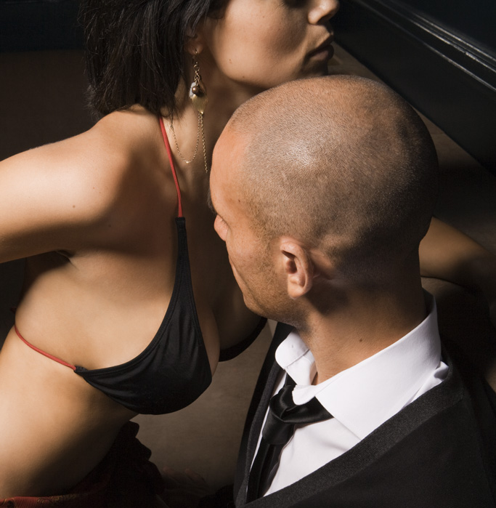
What do you consider cheating?
nude cuddling,
deep kissing
emotional intimacy,
cybersex
BDSM,
phone sex, happy ending
massage
dirty dancing,
dinner at a restaurant
g-spot massage,
prostate massage
sexual intercourse,
oral sex, anal sex
Notes:
AVA - How many of you consider dinner at a restaurant or dirty dancing as cheating raise your hand? None…In our survey these were defined as cheating by a small but significant percent. Perhaps it depends upon who you are having dinner with and if you are eating it off their body while dirty dancing. What about emotional intimacy and or cybersex, how many of you would define either one as cheating? Once again some of our participants defined these as cheating. What about cuddling in the nude and deep kissing as opposed to a peck on the cheek? Raise your hands if you think these are cheating. BDSM, phone sex and happy ending massage are all services that you can pay for, but how many of you would define these as cheating? What about G-spot massage and or prostate massage or milking the prostate as I like to call it. You can visit a Tantra practioner and or sex surrogates to explore your G-spot or prostate, but is it cheating? And finally, sexual intercourse, oral sex and or anal sex. How many of you would define these sexual activities as cheating? Surprise Surprise, most of you would and most of our participants agreed with you.

Slide 11
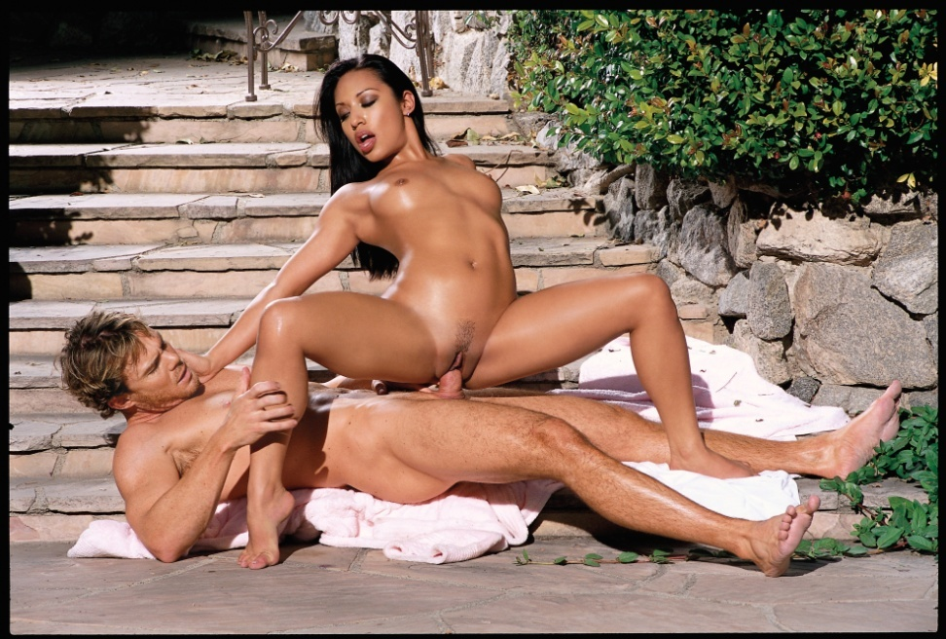
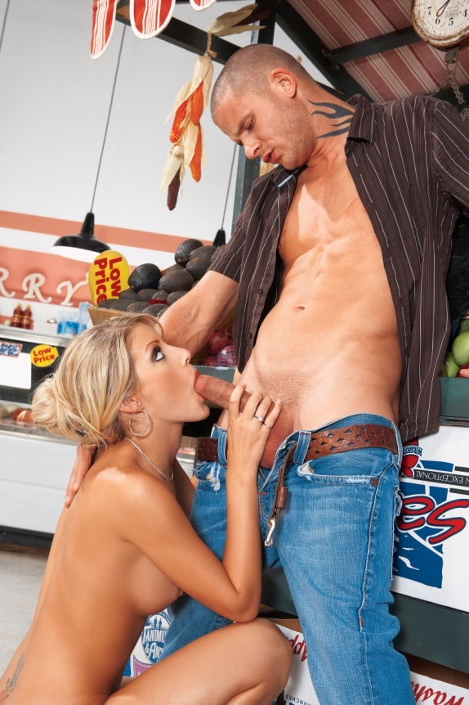

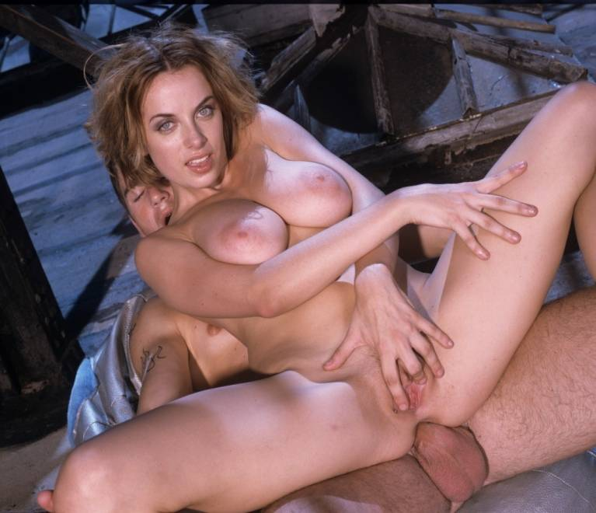
Top Cheating Activities
Penile-Vaginal Intercourse | 95%
Anal Intercourse | 92%
Giving Oral Sex | 92%
Receiving Oral Sex | 92%
Notes:
AVA – So these are our top cheating activities. Sexual intercourse defined as cheating by 95% of our participants, but 5% of them did not think it was cheating. Receiving oral sex, 92% thought that was cheating, Bill Clinton would say it’s not. Giving oral sex was the same percentage as receiving oral which was interesting and then Anal intercourse, only 92% said that was cheating, possibly because you can still maintain your virginity and can’t get pregnant.

Slide 12
Notes:
Leanna- So this is what our survey looked like, the pink is female and the blue is male and here you can see our top cheating activities. Truly our males were less likely to consider receiving oral sex to be cheating. Here we start seeing some dramatic differences between females and males where 89% of females consider deep kissing to be cheating where just 73% of males considered it and likewise with BDSM we see a point spread between males and females.

Slide 13
Notes:
Leanna – Now here we see even more dramatic differences between males and females, based upon people who have been cheated on. These are considered the most cheating sensitive. Phone sex, light kissing had 24% point spreads, other differences were cybersex and clothed cuddling with dramatic differences between males and females. While you may not have thought dirty dancing was cheating, here you can see that 42% of females who had been cheated on considered dirty dancing to be cheating as did 41% of females considered Tantric breathing or dinner in a restaurant to be cheating while the males were much less.

Slide 14
Reflections on being a cheater
I think that cheating is wrong but, much to my surprise, have found myself doing it... I would not have believed I would ever even be tempted, or think it right to give in to temptation, but a bunch of things changed and surprise surprise!
I have cheated to find a better partner, without letting go of the security of having at least some kind of partner.
I cheated for a long time, made excuses and bullshitted myself, but I still don't understand why I did it. I was unhappy with my marriage and too big a coward to end it. I just kept on lying to myself and those around me.
Female,
41
Female,
37
Male,
64
Notes:
AVA – Now we have some interesting reflections on being a cheater which we would like you to guess the gender and the age of each one. (Ava reads) Raise your hand if you think this is a man, raise you hand if you think it’s a woman. Can anybody guess what age this woman is? The next reflection (Shelly reads), Raise your hand if you think this is a man, a woman, what about the age? (Leanna reads last one) who thinks this is a woman, a man and how old do you think this man is? What did we learn from this? Lots of significant findings (go to next slide)

Slide 15
Significant Findings
Males more likely to cheat
Females more likely to report being cheated on
< 35 most likely to cheat for attention
> 35 most likely to cheat in pursuit of sexual variety
Majority of cheaters contend cheating unacceptable
72% who cheat have also been cheated on
Males enjoy cheating more than females do
Females who have been cheated on are more troubled by an emotional connection
Excitement more important to cheating males than cheating females
Notes:
Leanna - Cheaters come in all genders and ages, but men are more likely to cheat and women are more likely to be cheated on. Those under 35 were most likely to cheat for attention…Those over 35 were most likely to cheat in pursuit of sexual variety wanting something their partner at home was not giving them. Altogether, the majority of our respondents who were cheaters contended that cheating was unacceptable nonetheless, they were all engaging in it.

Slide 16
Secret Lovers
Males 56.7% | 54% between 36 and 55
Females 57.1% | 60% between 24 and 45
Notes:
Leanna – There were really close numbers of male and female secret lovers, but our female lovers were younger than our secret male lovers with the median age for males at 36 to 55 while for females it was 24 to 45.

Slide 17
Notes:
AVA- What do secret lovers feel about being secret lovers? We can see some dramatic differences between males and females in the Disappointment category as well as the Exhausting category, as for Excitement that is still the most common response, though the males are 77% while the women are a bit lower at 68%. In other areas
men are much more satisfied, those who are scared have pretty equal numbers, but again the females are much more troubled by this and the males more likely to call it Life Enhancing.

Slide 18
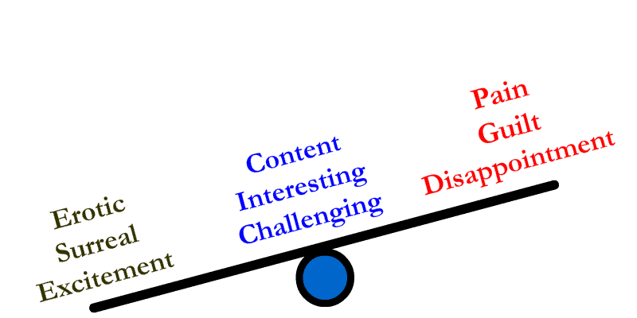
Secret Lover’s Mixed Emotions
Notes:
AVA: So what we found is there are a plethora of mixed emotions from great joy to great sorrow including: the highs of excitement, surreal fantasies, eroticism to the lows of disappointment, guilt and pain. But we also found there were some people who were right in the middle who were content with having a double life, with being a secret lover and some of the words they used were, challenging, interesting, and content. I have a client who cheats, and she tells me that she gets so excited when she’s about to cheat with a new lover, but after the sex she’s always frustrated because the sex wasn’t as good as she had imagined and then she’s disappointed, feels unhappy, guilty but can’t wait to meet another lover. So it’s a see-saw of emotions.

Slide 19
Potential Cheaters
Those who are in committed relationships
(People who are single and/or in open relationships were excluded)
Notes:
Leanna – Analyzing our data, one of the groups I pulled out were called, Potential Cheaters. These are people who were in committed relationships so I separated out people who were single and people who were in open relationships. The males were more likely to have cheated and the females where more likely to be cheated on.

Slide 20
Notes:
Leanna: The top reasons Potential Cheaters claimed that they cheated were: Believing they can get away with it and Feeling alive again. The turquoise is Believing they can get away with it, what we are seeing here is that our young cheaters under 35 are cheating because they believe they can get away with it. Both males and females claimed that Seeking to Feel Alive Again was a reason to cheat, but males were 45% while females were 21%.

Slide 21
Notes:
LEANNA – We also asked this group why they would cheat and found some differences in gender and age here. So cheating for better, different or more sex was much higher for males than women at 70% for men and less than 40% for women. Now in terms of ages, we’re seeing our older cheaters picking younger cheaters.

Slide 22
Combo Cheaters
People who have both cheated and been cheated on
(72% who cheat have also been cheated on)
45% Male | 57% between 36 and 55
55% Female | 60% between 24 and 45
More male combo cheaters than female
These males have the highest appetite for more/better/different sex (70%)
Notes:
Leanna – These people have cheated and have been cheated on. Here we’re seeing 45% of them were male and 55% of them were female. In this group there were more male combo cheaters than females in terms of who had been cheated on in numbers and these males had the highest appetites for more/better/different sex and our combo cheater males tending to be older than our combo cheating females.

Slide 23
Justifications for cheating
Notes:
LEANNA: Here I decided to compare Combo Cheaters versus Potential Cheaters. And what we’re seeing here in terms of sexless marriage or relationship, is that combo males are more robust in their reason s for cheating. They are more likely to pick the sexless marriage as a reason for cheating, where the Potential males in less numbers, and Combo males are also likely to pick the partner unable to have sex for medical reasons as a reason to cheat and the Potential males were lesser in those categories. When we compared the Combo females with the Potential females, they are very similar. There’s little difference in whether a woman has cheated or not in terms of her justifications for cheating.

Slide 24
Notes:
AVA – Here we looked at why or when cheating would be acceptable. The most common choice was that there were NO reasons. From our total survey 49% from our males and 59% for our females chose None. Our younger group ages from 18 to 23 also said that cheating was unacceptable and chose None. As our respondents got older there were more and more reasons, between 46 and 55 who chose a sexless marriage was a good reason to cheat. So we can see there are clear differences between genders and ages in terms of why people think cheating would or would not be acceptable.

Slide 25

Cheating Has no Age Limit
Males, Boomers and Gen Y find the most satisfaction with cheating
Females and Gen X report higher levels of discomfort with cheating
Older men cheat with younger women and younger women cheat with older men
The median age for cheating is 36-45 for men and women
Younger cheaters contend no acceptable reasons to cheat
Older cheaters consider a sexless marriage/relationship a justification for cheating
Notes:
Leanna: Basically when we started looking at all the different ages, the conclusions that we draw is: Males, Boomers and Gen Y find the most satisfaction with cheating. They are definitely in the attachment phase of their relationships so they are seeking excitement and to feel alive again. Now our Gen Y people are finding satisfaction in cheating because their parents are Boomers and maybe they have taken on some of the same values as their parents. Our Gen X respondents had higher levels of discomfort with cheating, these are people who come from a more conservative generation. They easily found jobs after college, raising young families. They have different values. Older men are cheating for excitement with younger women. Younger women are cheating with older men for attention. They are each drawn to each other for different reasons.

Slide 26
Male vs Female cheating Conclusions
Males define cheating when there is genital contact
Males cheat for excitement
Males cheat to live out their sexual fantasies
Males believe they can get away with cheating
Females consider emotional connection to be cheating
Females cheat for attention
Female secret lovers find less satisfaction
Females more likely to consider cheating to be wrong
Notes:
AVA: We were able to draw gender conclusions with some dramatic differences between how males define cheating and the reasons males cheat versus female definitions and reasons for cheating. Men are more likely to define cheating as when there is genital contact whereas females consider emotional connections such as having dinner to be cheating as well.
Males are cheating for excitement, females are more likely to cheat for attention.
Males cheat to live out their fantasies. In fact a lot of men would rather live out their sexual fantasies with a stranger than their spouse because they don’t fear the same kind of judgment, rejection or even ridicule from someone who doesn’t know them so well. Female secret lovers find less satisfaction from cheating, even if they live out their fantasies.
Men believe they can get away with it, that might be one reason they are not as discreet as they should be and females are more likely to consider cheating to be wrong so perhaps they analyze it more and then feel more guilty.
Cheating is on the rise, maybe Viagra and Estrogen replacement has contributed, the web certainly makes cheating easy and we are bombarded with politicians, sports figures, and celebrities cheating in the media.

